Slide 1


Easy Mission
Élaboré par: Ahmed Bettaieb
Marwen Salhi
Darine Ben Mekki
Mohamed Amine Layouni
Slim Siala
Youssef Khadhar

Slide 2
Plan
Introduction
Context(Existing Analysis)
Use Case diagram
Mockups
Class diagram
Road Map
Architecture
Conclusion

Slide 3

1
INTRODUCTION

Slide 4


Context (Existing Analysis)

Slide 5

Existing critique

Slide 6
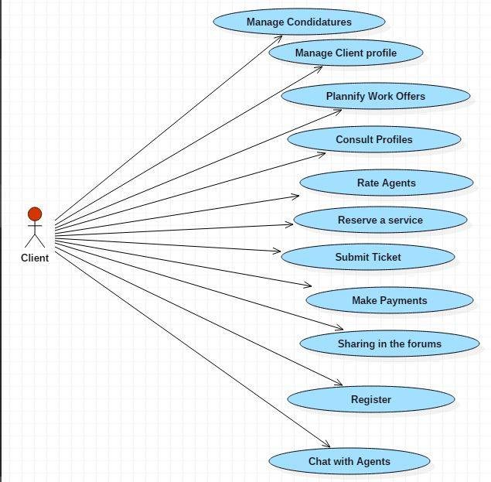
Use case Diagram (1/3)

Slide 7
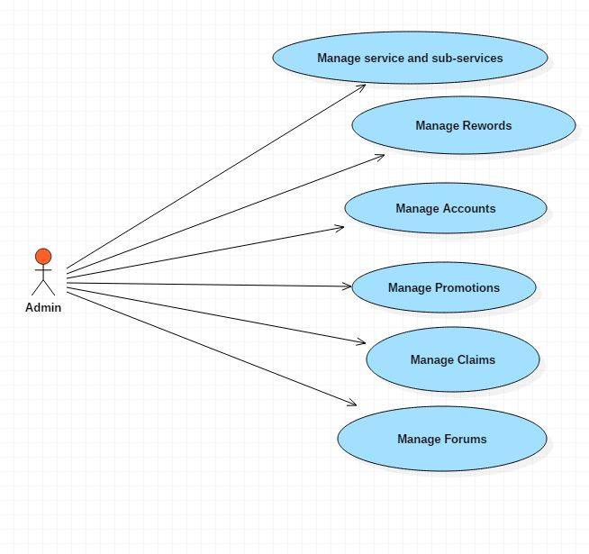
Use case Diagram (2/3)

Slide 8
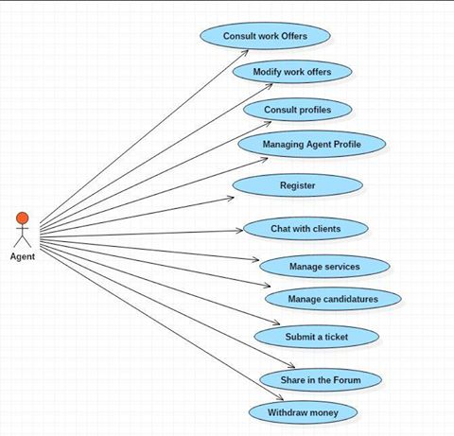
Use case Diagram (3/3)

Slide 9
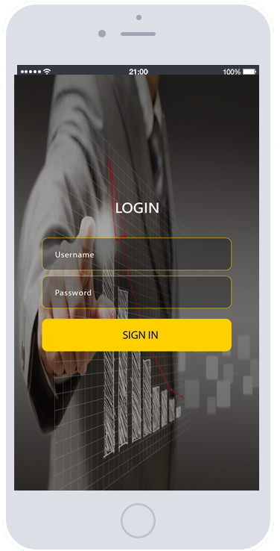

Mockups(1/5)

Slide 10

Mockups(2/4)

Slide 11
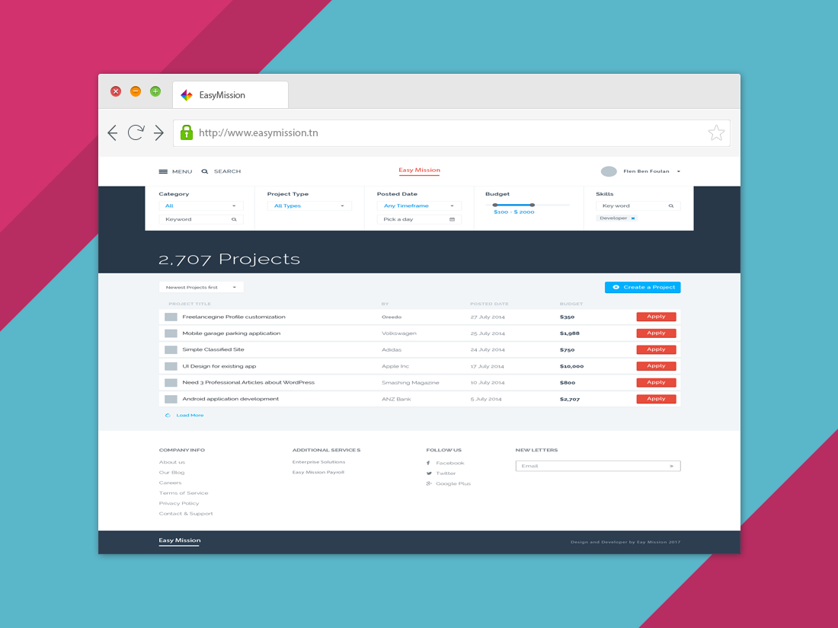
Mockups(3/5)

Slide 12
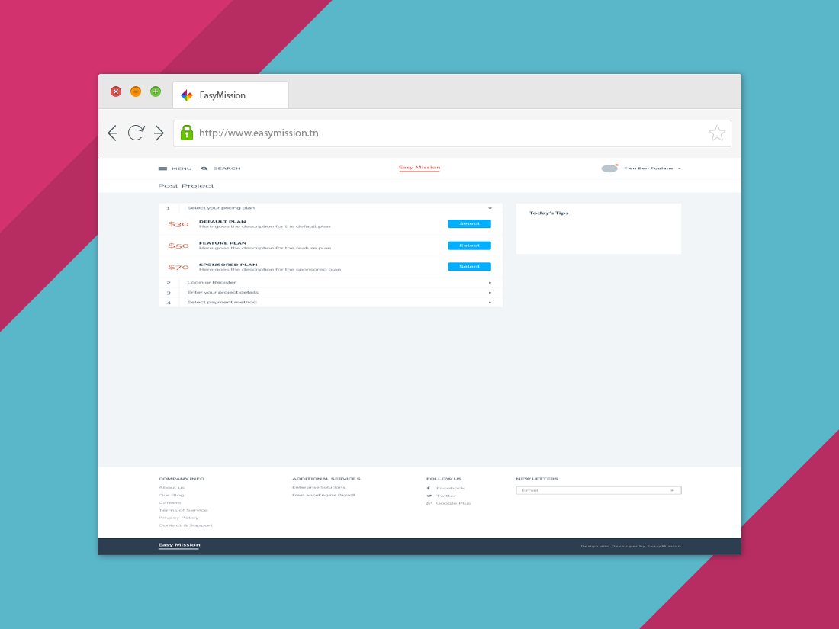
Mockups(4/5)

Slide 13
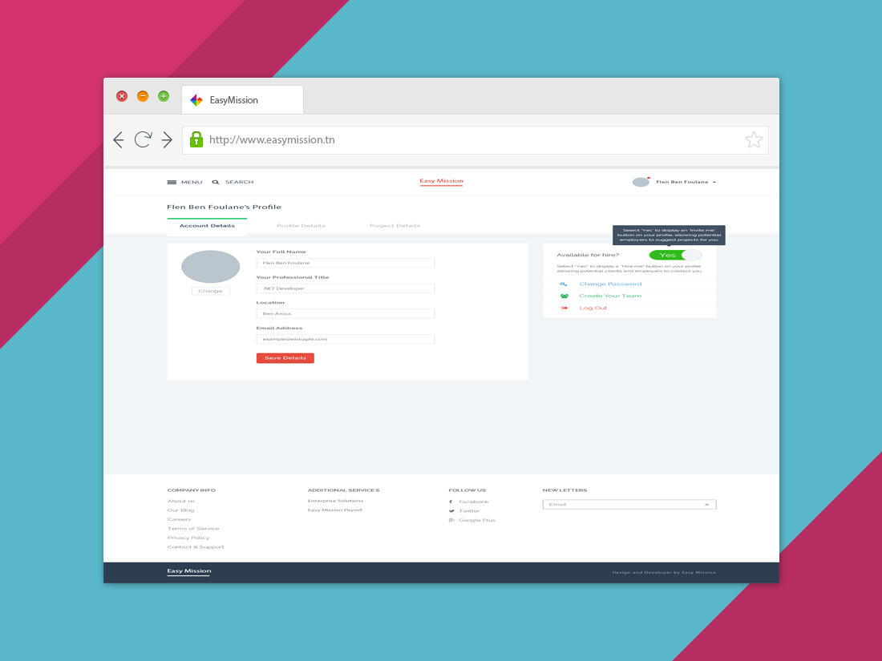
Mockups(5/5)

Slide 14
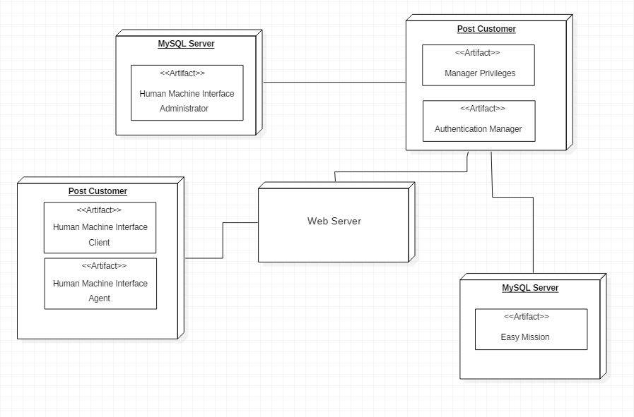
Class Diagram

Slide 15
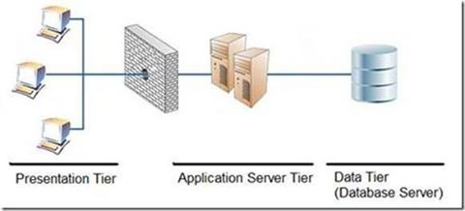
Architecture (Logical)

Slide 16
Architecture (Physical)

Slide 17
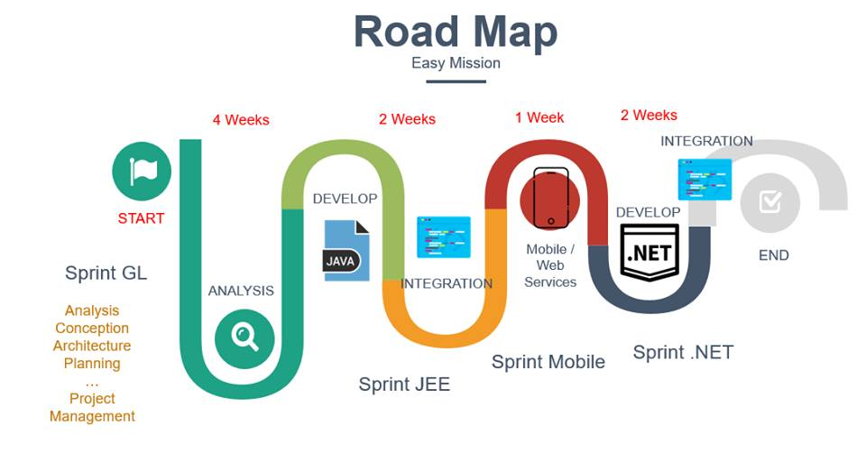
RoadMap

Slide 18
6
Conclusion

Slide 19
Thanks for your Attention

